Slide 1
Music Video Narratives

Slide 2
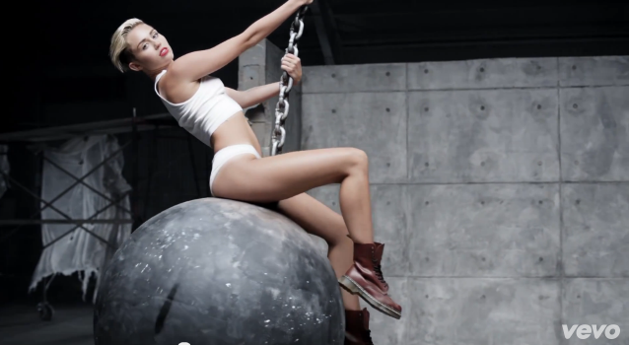
Miley Cyrus – Wrecking Ball
This music video has a circular narrative as it starts and finishes in the same place. This is a very simplistic video with few cuts and is shown as a more revealing piece of film. We see Miley Cyrus in minimal clothing promoting her body towards the audience. She is also trying to convey power through the use of heavy and strong materials such as brick and steel.
http://www.youtube.com/watch?v=My2FRPA3Gf8&list=TLlmXQ8ZvqjltTwVr7CturbHiJBassJQCB

Slide 3
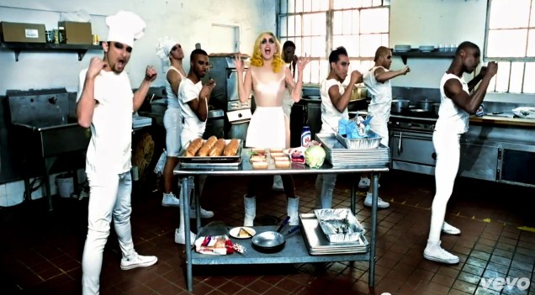
Lady GaGa – Telephone feat. Beyonce
This music video contains Todorov’s theory of equilibrium, disequilibrium and then equilibrium again as the plot shows how both artists notice a change and go through a short journey together as Lady GaGa is bailed out of prison and then her and Beyonce know that a climax is on its way. We know this because it is later revieled that the both have been poisoning people in a diner but then run away so everything becomes normal again.
http://www.youtube.com/watch?v=EVBsypHzF3U

Slide 4
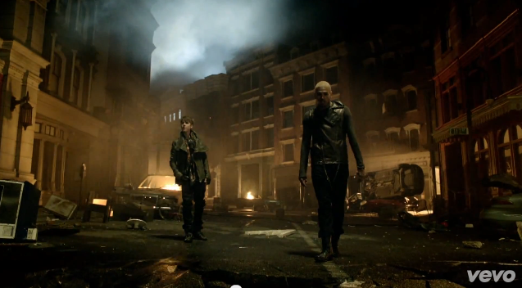
Chris Brown – Next To You feat. Just Bieber
This video connotes the linear theory as we go through a journey of the world coming to an end, and there is no happy ending. We can see that there are explosions and destruction happening in the environment and both artists are suffering loss. Although most of the video is chronological, there are flashbacks from when their lives were once considered normal.
http://www.youtube.com/watch?v=EEuQU6a90Pc

Slide 5
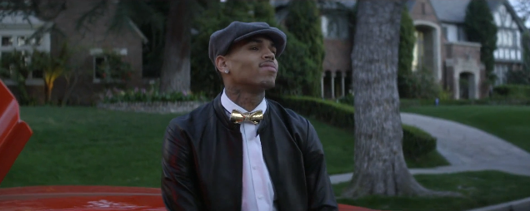
Chris Brown – Fine China
This music video has a linear narrative as it
starts in one place and finishes at another. During the video Chris Brown takes a girl to what seems to be a very urban club and then is provoked afterwards by the girls dad. This music video isn’t necessarily conventional as it has amore technologic and modern feel to it.
http://www.youtube.com/watch?v=EEuQU6a90Pc

